Slide 1



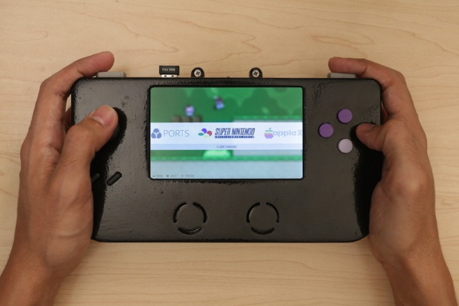
The Maker Movement
The Beauty and Joy of Computing Lecture #11
Social Implications II
Jonathan
McKinsey
https://www.youtube.com/watch?v=Wuza5WXiMkc
https://www.youtube.com/watch?v=f_zp42fQ-dQ
http://time.com/104210/maker-faire-maker-movement/

Slide 2
Computing Enables Innovation

Slide 3
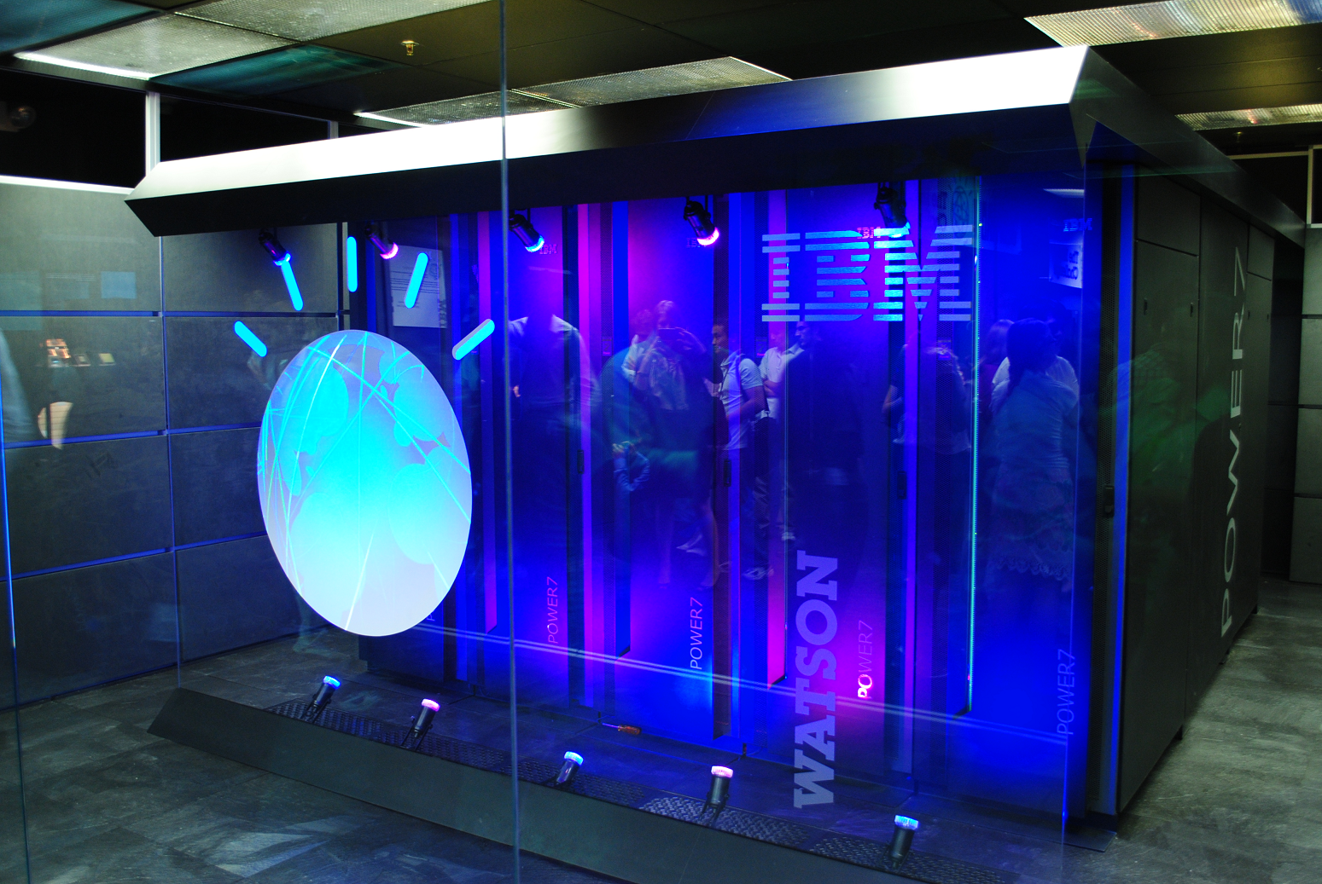
Computing Enables Innovation I
Machine learning and data mining have enabled innovation in medicine, business, and science.
Computing enables innovation by providing the ability to access and share information.
Open and curated scientific databases have benefited scientific researchers.
IBM Watson (Image by Clockready, Wikipedia)

Slide 4
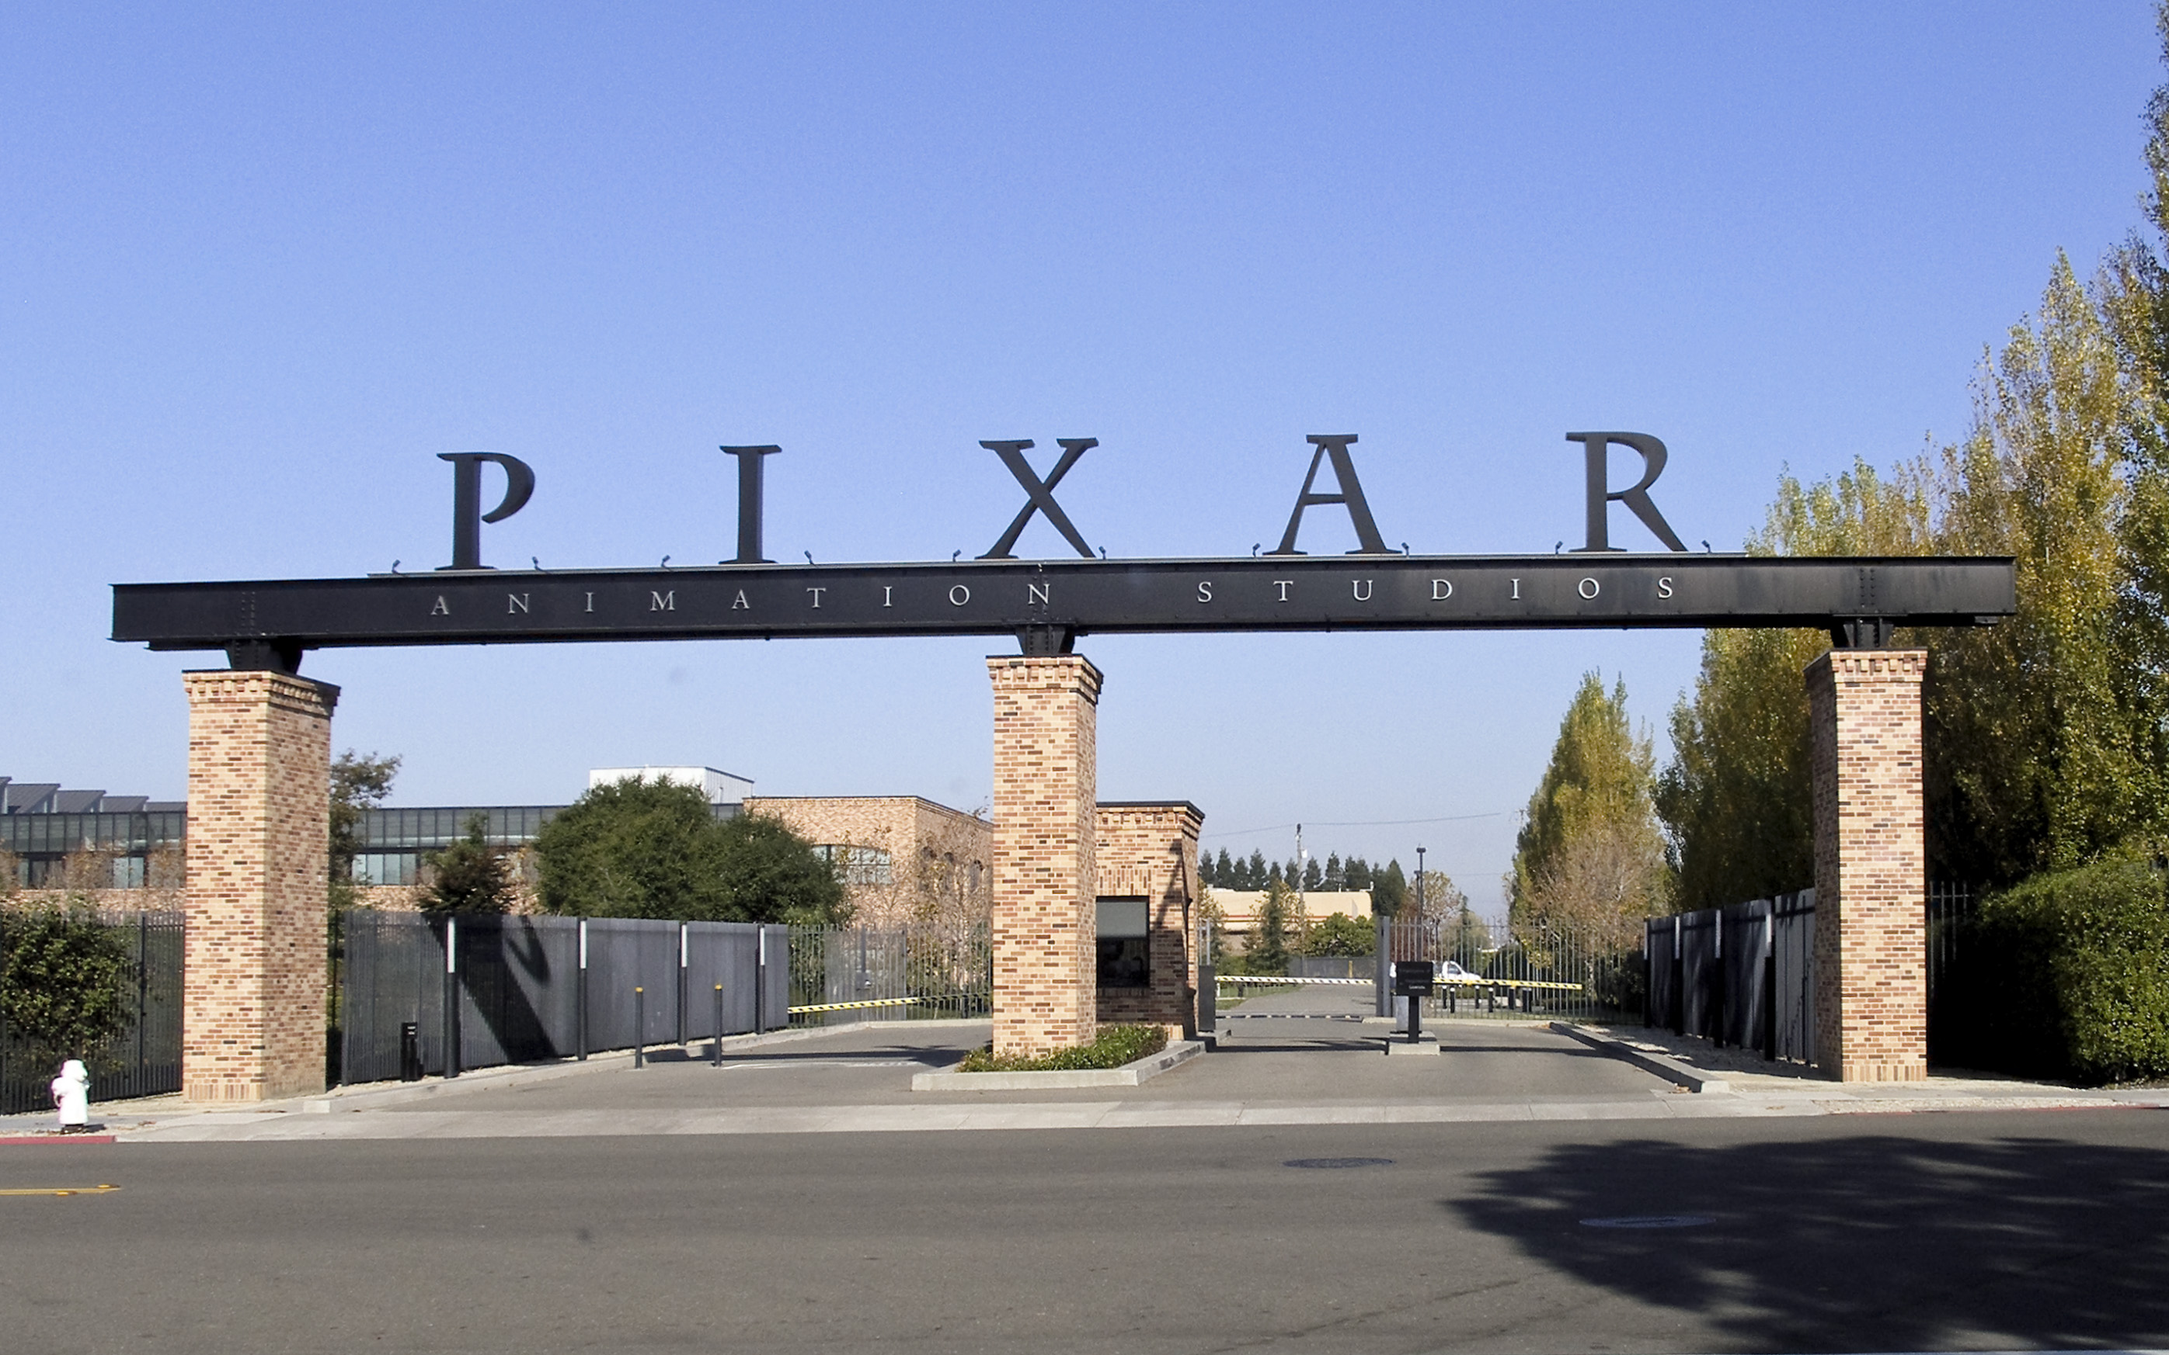
Computing Enables Innovation II
Moore’s law has encouraged industries that use computers to effectively plan future research and development based on anticipated increases in computing power.
Advances in computing as an enabling technology have generated and increased the creativity in other fields.
Moore’s Law (Image by Loadmaster, Wikipedia)
Pixar Studios (Image by Coolcaesar, Wikipedia)
☑

Slide 5
Economic, Social, Cultural Contexts

Slide 6

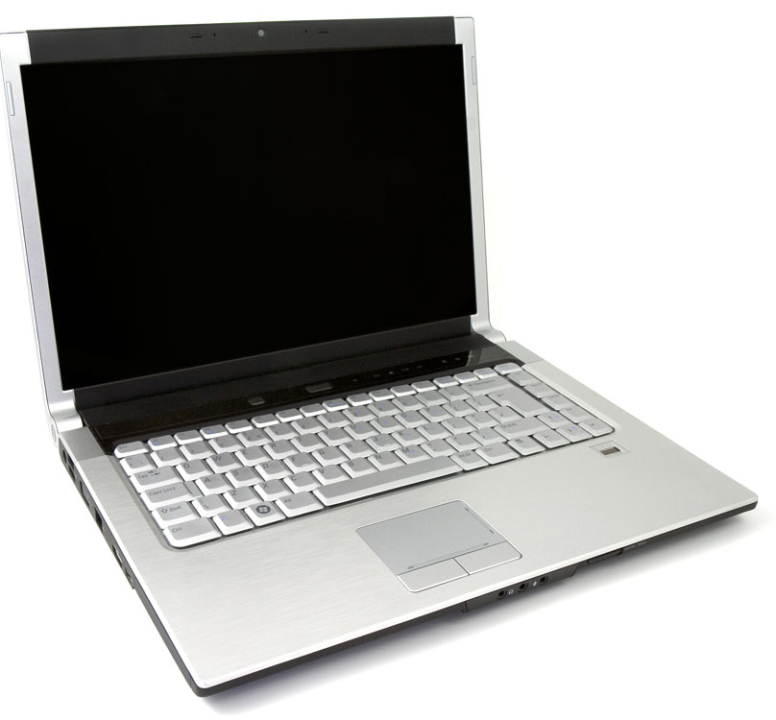
Economic, Social, Cultural Contexts I
Computing innovations influence and are influenced by the economic, social, and cultural contexts in which they are designed and used!
Laptop (Image by Petr Kratochvil, publicdomainpictures.net)

Slide 7
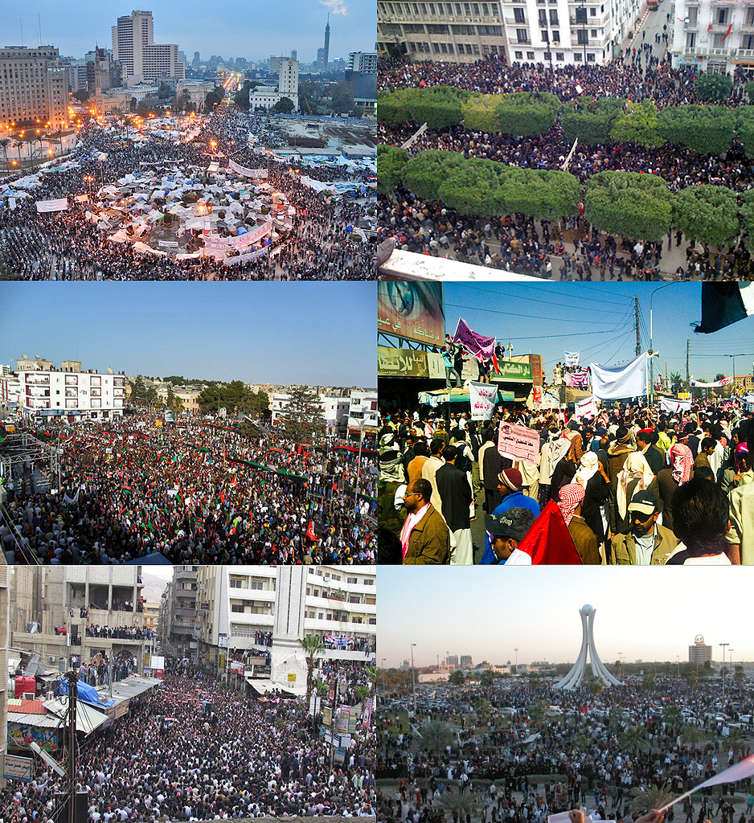
Economic, Social, Cultural Contexts II
Mobile, wireless, and networked computing have an impact on innovation throughout the world.
Networks and infrastructure are supported by both commercial and governmental initiatives.
E.g. Google Fiber
The innovation and impact of social media and online access varies in different countries and in different socioeconomic groups.
Arab Spring (Image by Soerfm, Wikipedia)

Slide 8
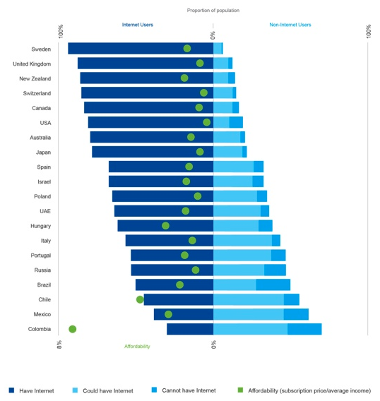
Economic, Social, Cultural Contexts III
The global distribution of computing resources raises issues of equity, access, and power.
Groups and individuals are affected by the “digital divide” — differing access to computing and the Internet based on socioeconomic or geographic characteristics.
Affordability
Quality of Service (QoS)
Language
http://news.bbc.co.uk/2/hi/technology/8552410.stm
http://techcrunch.com/2015/07/12/the-shrinking-digital-divide
http://www.wired.com/2015/01/the-digital-divide-is-not-binary
☑
Notes:
Mobile telephony grew faster than almost anyone would have predicted 15 years ago, to the point where at least 94% of the world’s population receives a signal. Internet access can be added to a mobile network with far less investment than building the original network, leading to a rapid rollout of mobile Internet service that already covers at least 48% of the population worldwide. And from a standing start just six or seven years ago, more than 28% of the population worldwide have already subscribed.

Slide 9
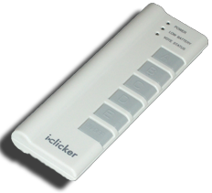
The best way to solve the Digital Divide is…
Free iPads for all kids
More computers in libraries
Free wifi for communities
One Laptop Per Child
Something else!
http://www.latimes.com/local/lanow/la-me-ln-ipad-curriculum-refund-20150415-story.html
http://one.laptop.org
http://www.businessinsider.com/9-cities-with-the-best-free-wifi-2014-2
Notes:
Taipei, Taiwan
Florence, Italy
Tel Aviv, Israel
Helsinki, Finland
Hong Kong, China
Macau, China
Paris, France
New York, USA
Perth, Australia

Slide 10
Where do you get your music?
I bought everything, as a download or ripped from CD
I bought most of my music but there are a few exceptions
I bought a little of my music, but most of it I didn’t buy
It’s all from BitTorrent/ friends/ etc
Notes:
Answer: D (includes everything in which the computer poses a question and you have to answer in a computer-readable form, which so far means multiple choice)

Slide 11
Intellectual Property

Slide 12

Intellectual Property via Copyright
en.wikipedia.org/wiki/Copyright_Term_Extension_Act
copyright.gov
Brian Harvey:
“We’re going to make a bargain with creators. We’re going to give you a limited time monopoly to profit from your idea in return for sharing your idea with us. …
Congress keeps extending the duration of copyright”
US Constitution, Article I, Section 8:
“The Congress shall have power… to promote the Progress of Science and useful Arts, by securing for limited Times to Authors and Inventions the exclusive Right to their respective Writings and Discoveries.”
Logo for opposition to Copyright Term Extension Act (CTEA), or “Mickey Mouse Protection Act”
Notes:
Disney now has until 2023 to figure out how to extend that date once again. Enter Steamboat Willy, the first Mickey Mouse cartoon and the first animated short by Walt Disney in 1928. Under the 1909 Copyright scheme, the Mickey Mouse character had copyright protection for 56 years (with the renewal), expiring in 1984.
Works in the public domain are those whose intellectual property rights have expired, have been forfeited, or are inapplicable. Examples include the works of Shakespeare and Beethoven,

Slide 13
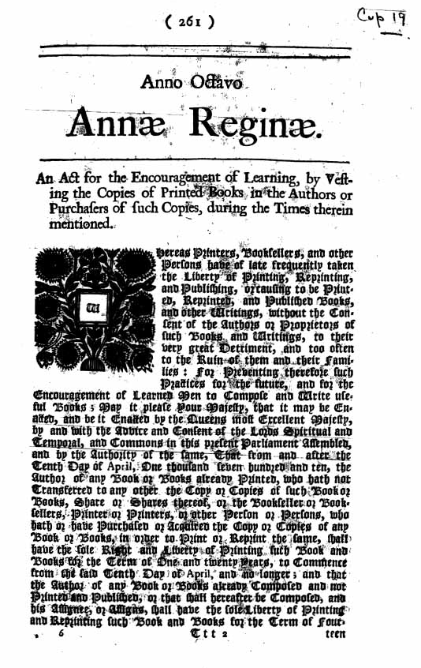
Economic, Social, Cultural Contexts I
en.wikipedia.org/wiki/Digital_Millennium_Copyright_Act
Widespread access to digitized information raises questions about intellectual property.
Creation of digital audio, video, and textual content by combining existing content has been impacted by copyright concerns.
The Digital Millennium Copyright Act (DMCA) has been a benefit and a challenge in making copyrighted digital material widely available.
The Statute of Anne, the origin of modern Copyright law, from 1710 (Public Domain)

Slide 14

Economic, Social, Cultural Contexts II
Legal and Ethical concerns are raised by
Innovations enabled by computing
Authenticated and anonymous access to digital information
Commercial and governmental censorship of digital information
Open source and licensing of software and content
Commercial access to music and movie downloads and streaming
Access to digital content via peer-to-peer networks

Slide 15
Creative Commons
creativecommons.org
A GREAT way to share / remix / reuse content
Legal!
Set of licenses
Website for sharing CC content
Open access and Creative Commons have enabled broad access to digital information.
BY = Attribution | Share Alike | No Derivatives | Non Commercial
CC BY
CC BY SA | x
CC BY ND |  | x
CC BY NC |  |  | x
CC BY NC SA | x |  | x
CC BY NC ND |  | x | x

